Slide 1
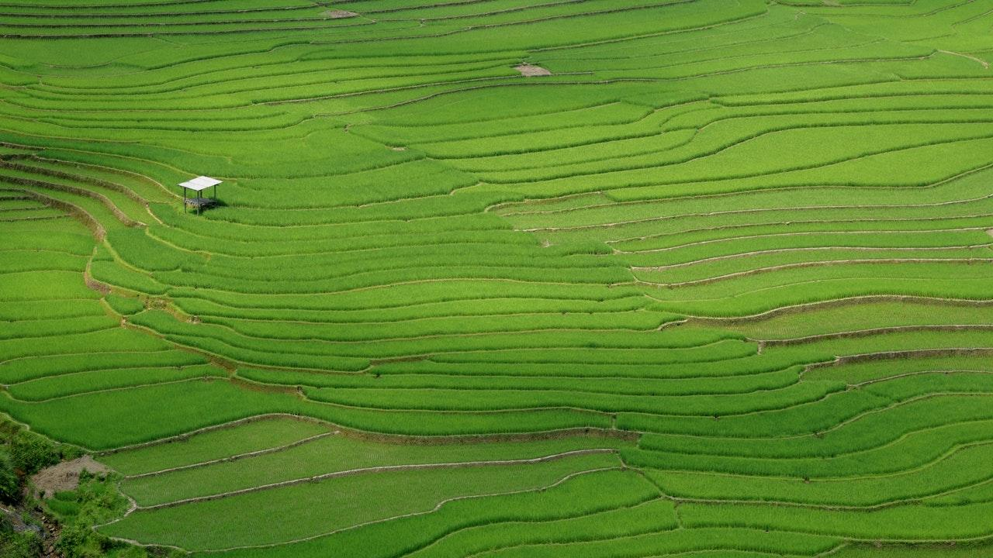
Save Environment Save
Humanity

Slide 2
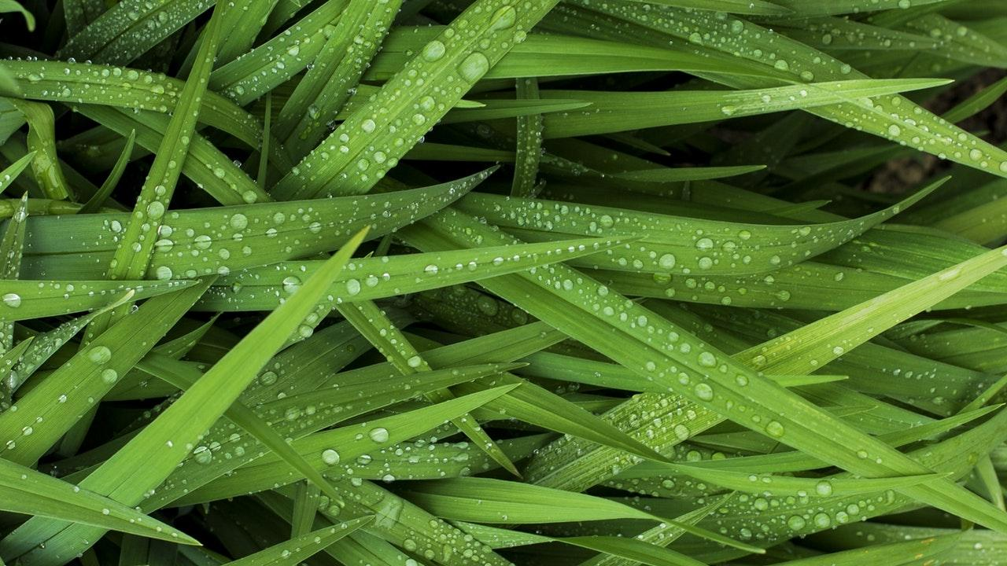
"Plans to protect air and water, wilderness and wildlife are in fact plans to protect man."
- Stewart Udall

Slide 3
Hello!
I AM DHRUV SAIDAVA
I am here because I want your help to Save Nature for you and me.
You can find me at @dhruvsaidava

Slide 4

What LIFE needs ?
LIFE
AIR
Food
WATER

Slide 5
Most Important for us
AIR Trees
WATER Rivers
FOOD Agriculture
From Day 1 in Human Race this is most common and as time goes we forgot value of this three important resources.

Slide 6
CAN WE Save Environment for Us?

Slide 7
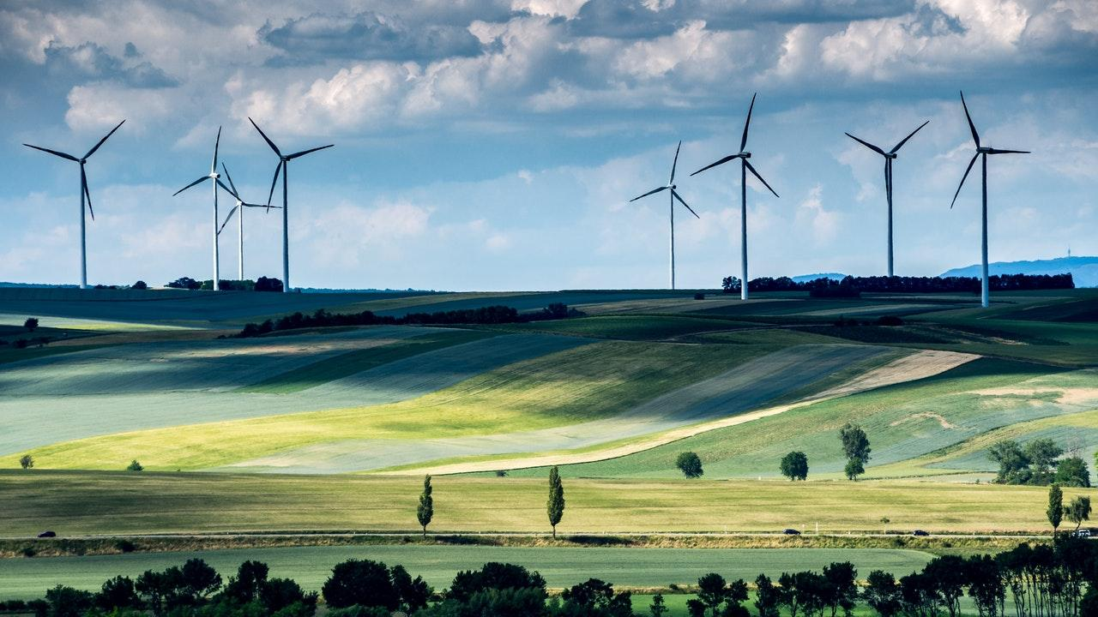
YES But All together Being Responsible To Save Nature

Slide 8
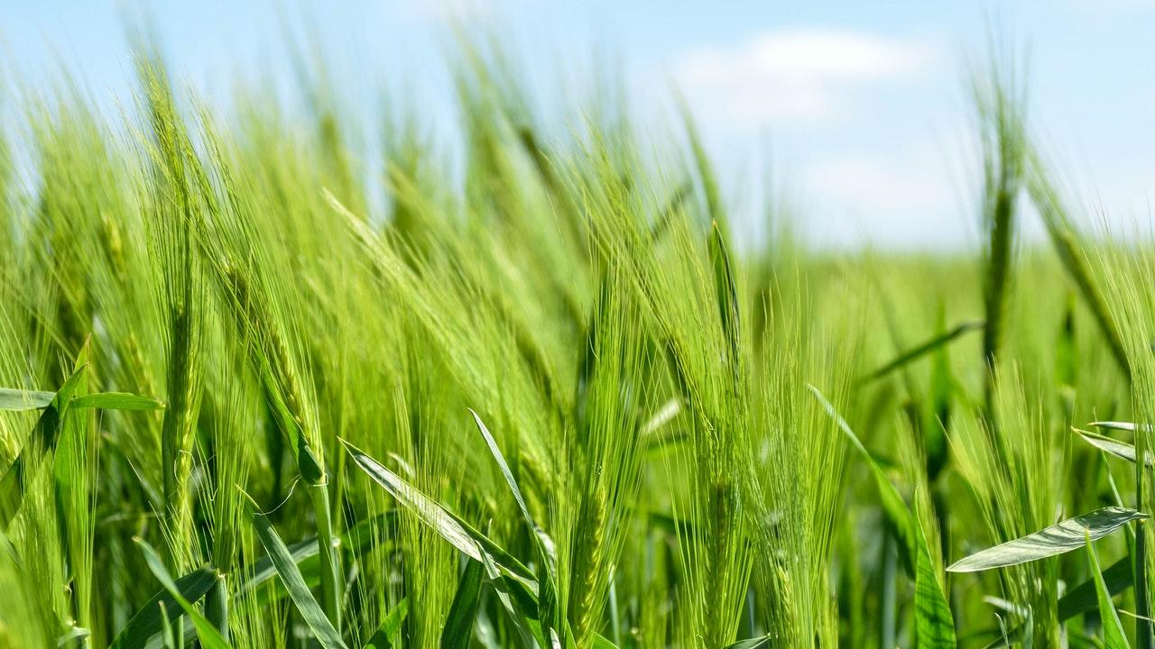
Flow of Workshop
( Reverse Engineering )
Test in field
Identifying Issues
03
01
02
Ideas to Solve

Slide 9
Issues related to Water
Let’s Talk only on 1 issue !!! Water
what cost and how much pure?

Slide 10
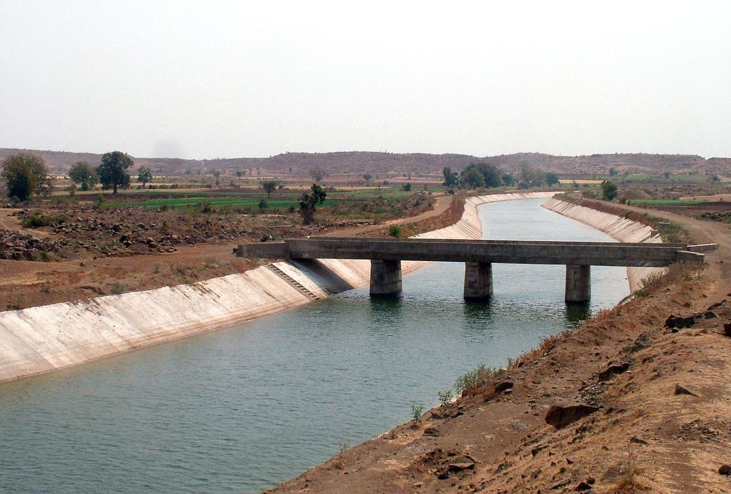
How much Cost & Energy it takes to Supply ?

Slide 11
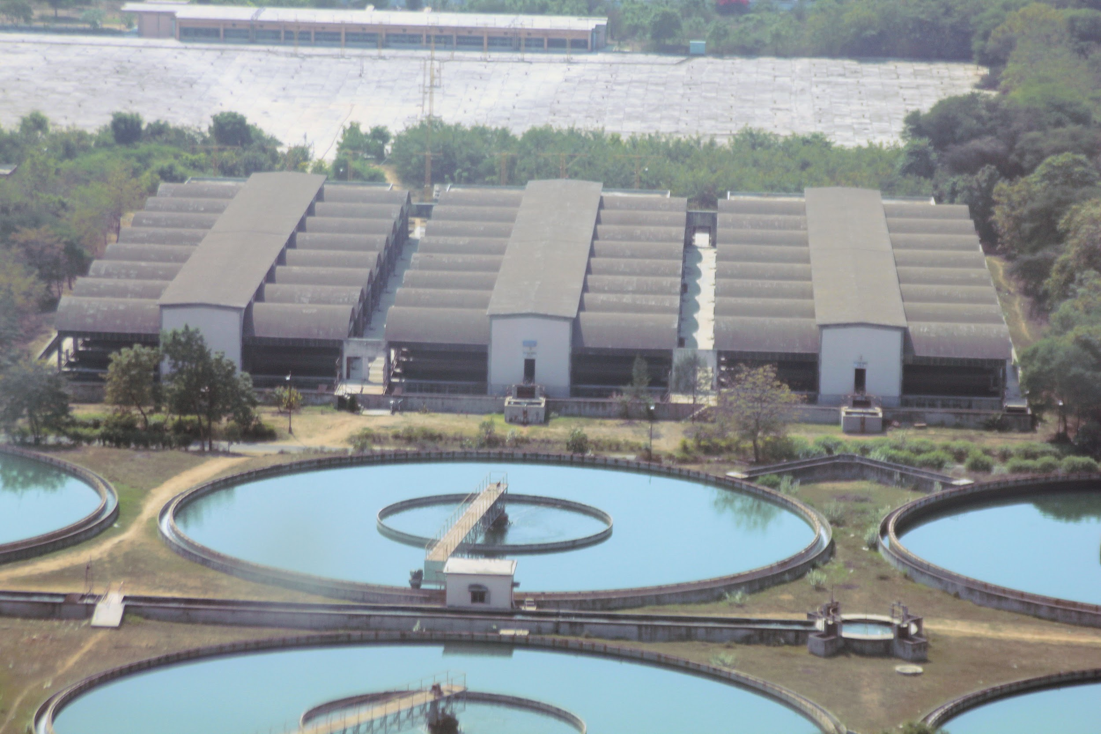
At what Value it is processed?

Slide 12
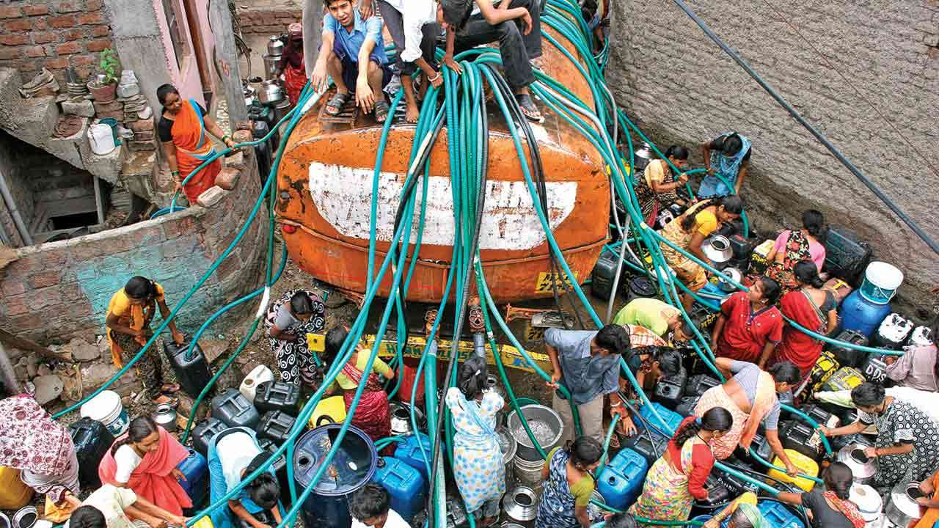
How much Drinkable water is wasted ?

Slide 13
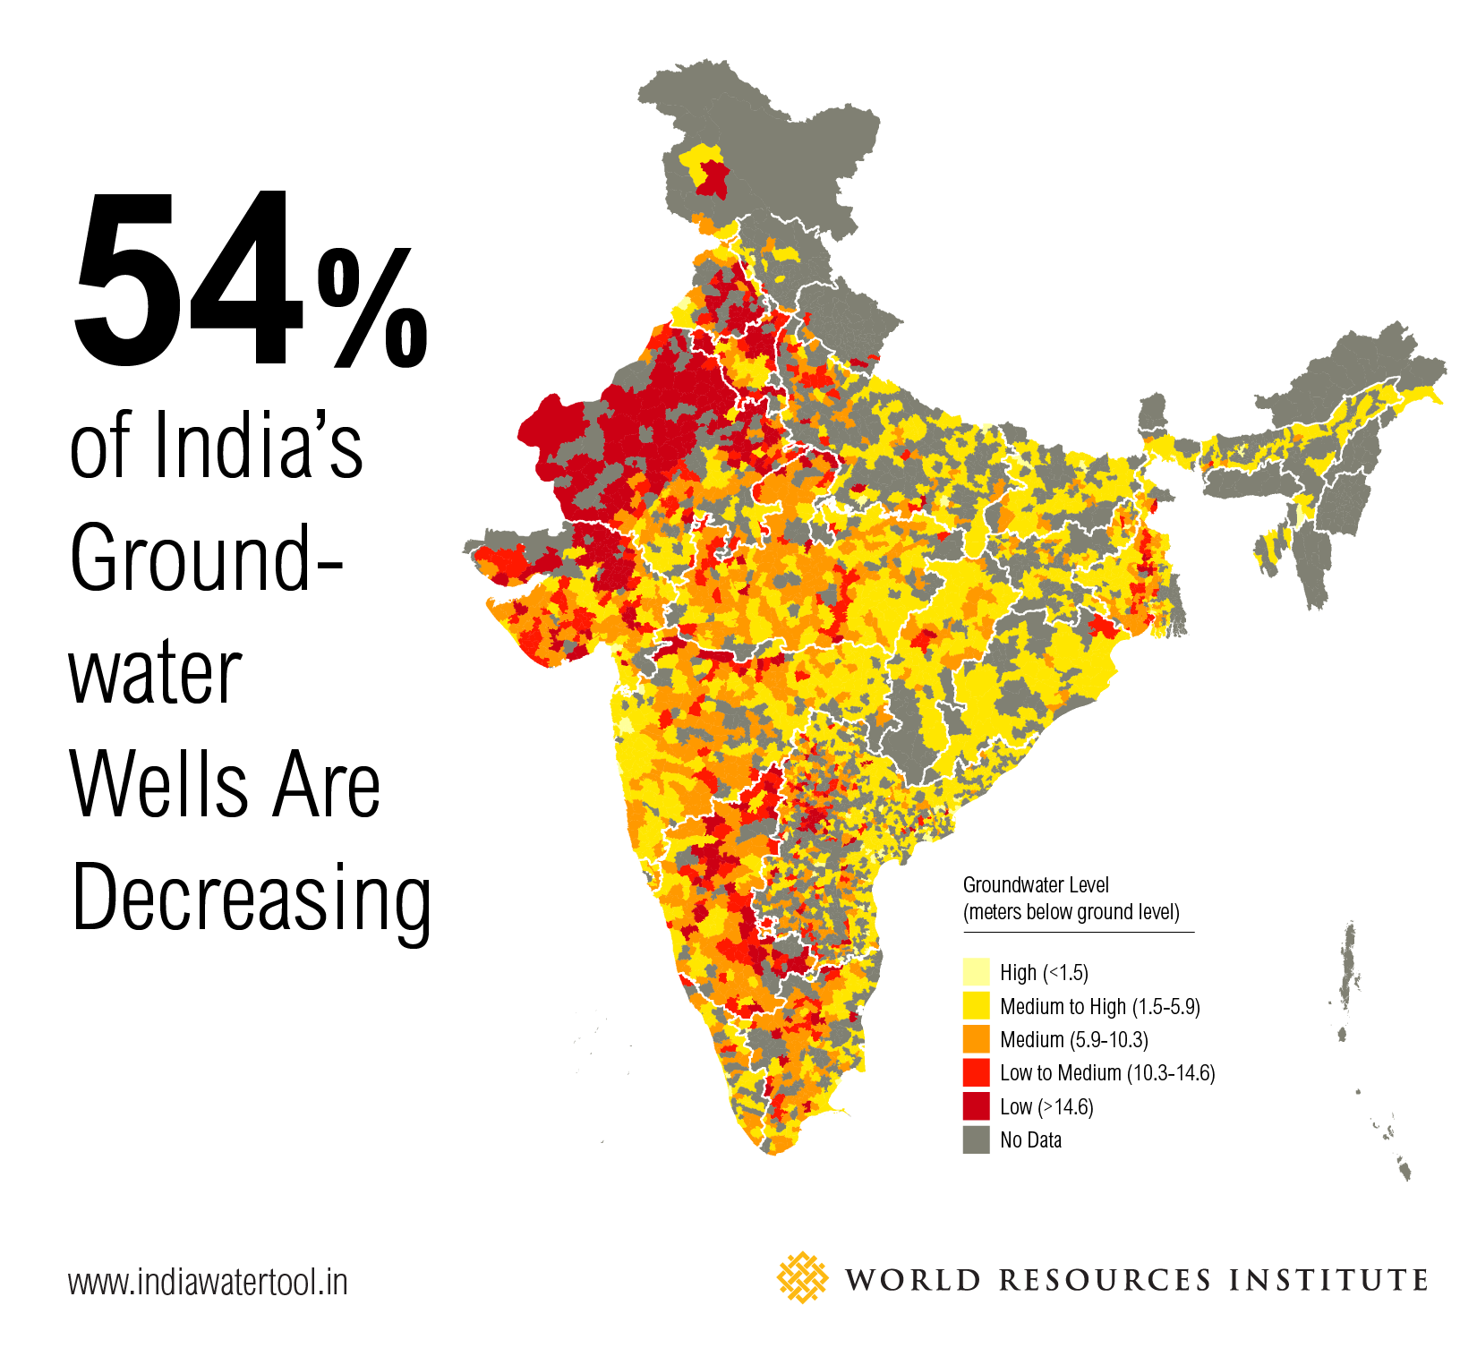
12 Years
?
What we will do after 2030….?

Slide 14
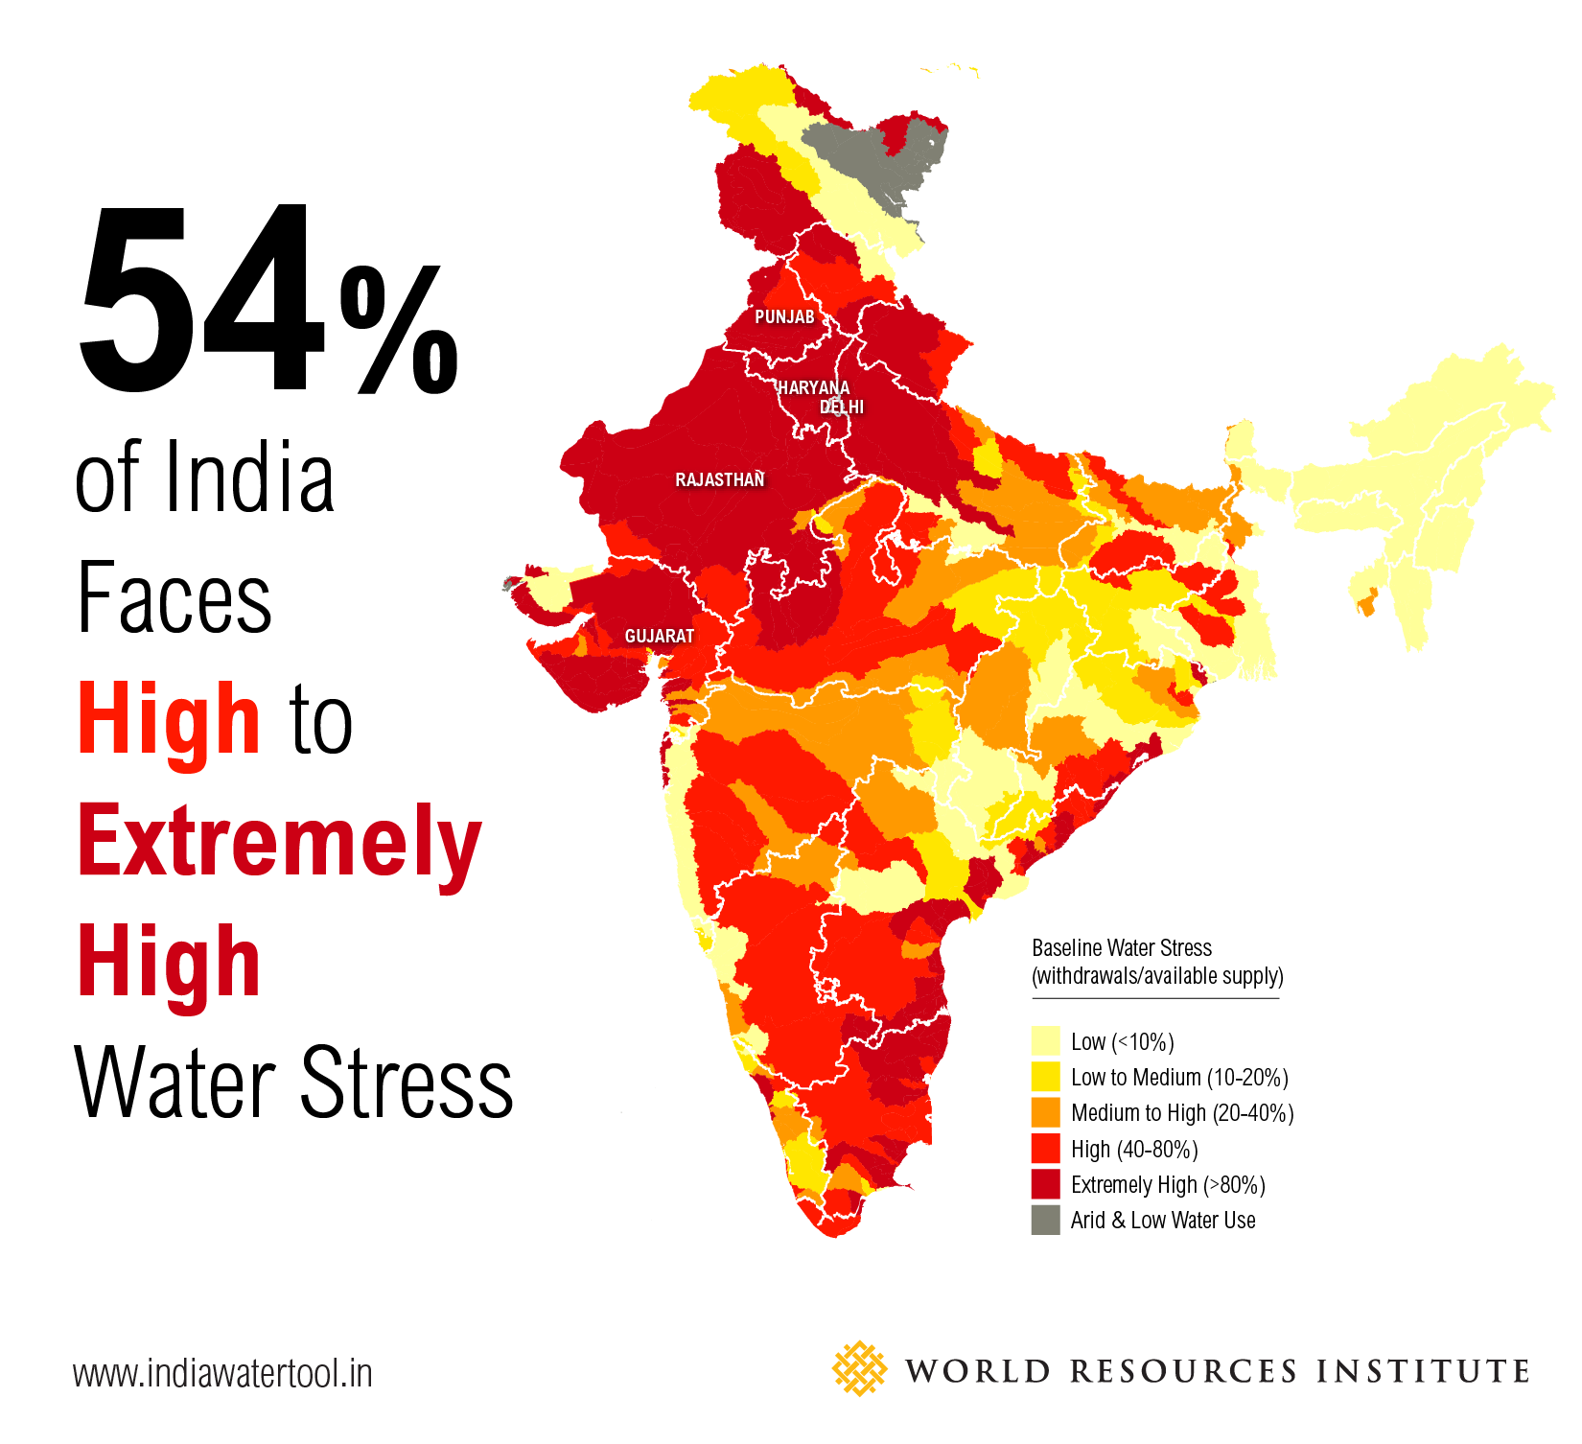
WAteR
?
What if they start war for
Water….?

Slide 15
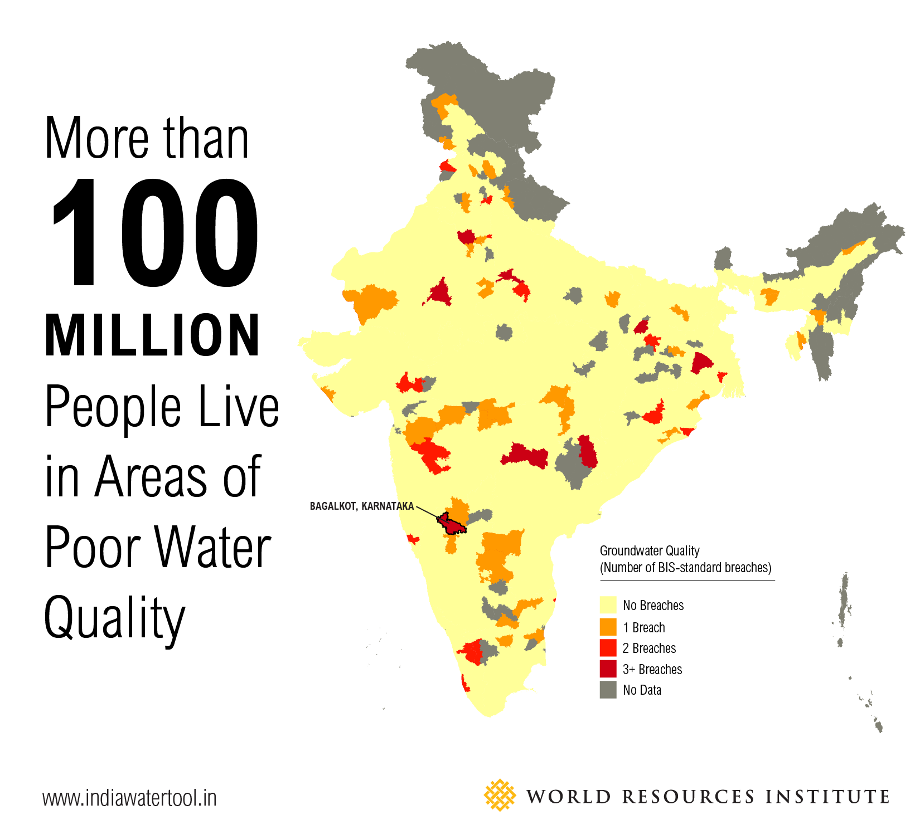
Heatlh
?
What About Health….?

Slide 16
2165130000 liter Daily Need of Ahmedabad
75% comes from Narmada Canal
An average Amdavadi consumes 260-280 litres a day against the supposed 143 to 171 litres a day required for day-today needs. Whoa! That’s a big number, aren’t you Amaze?

Slide 17
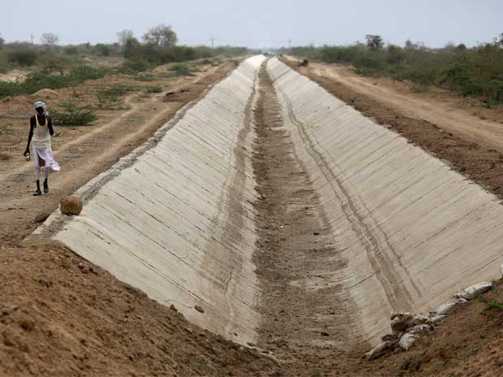
What if Canal is Empty ?

Slide 18
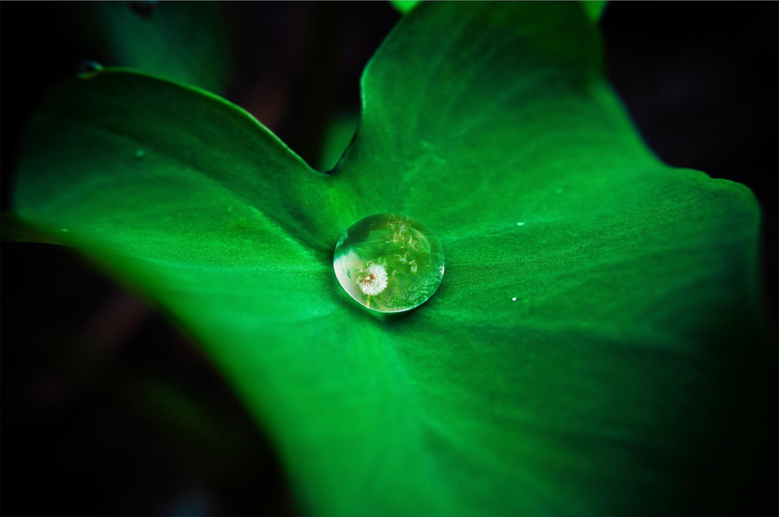
Issues
List down Issues you know related to water availability.

Slide 19

Pick One Issue and pitch.
Let’s start with the details and understand it better.

Slide 20
Team formation
Create Teams with Specific interest

Slide 21

10 Mins
Discuss on various problems and list them

Slide 22
How Simple we can Solve
Sometime a small logic can solve big problems
Let’s see how..

Slide 23

What
Can do

Slide 24


Slide 25
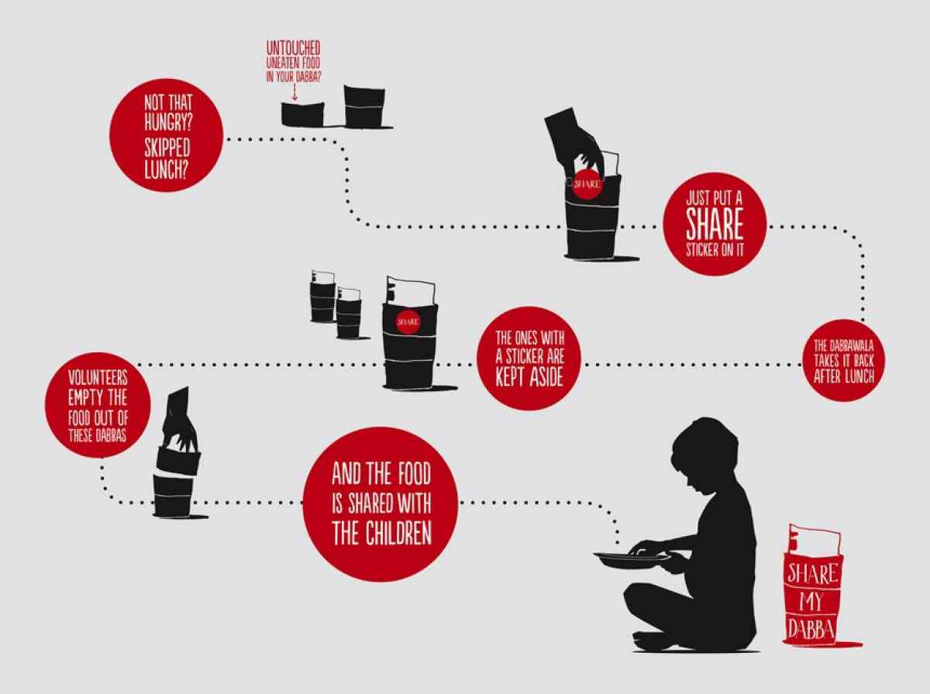

Slide 26


Slide 27
Work on Problem Statement for week
Create a Video Story
Speak with people to understand problem
Check with past data
Make small presentation or Speech of 8 Points.

Slide 28
Let’s talk Creative and amazing solutions to save water

Slide 29
Team Future Phoenixes
Water Management

Slide 30
Team Emerging Champs
Water Supply

Slide 31
Team LeakX
Water Leakage

Slide 32
Team Quality Members
Water Quality

Slide 33
Team
Water Harvesting

Slide 34
Team
Water Awareness

Slide 36
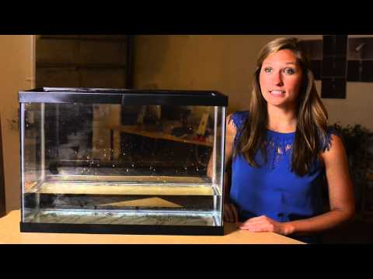

Slide 37


Slide 38
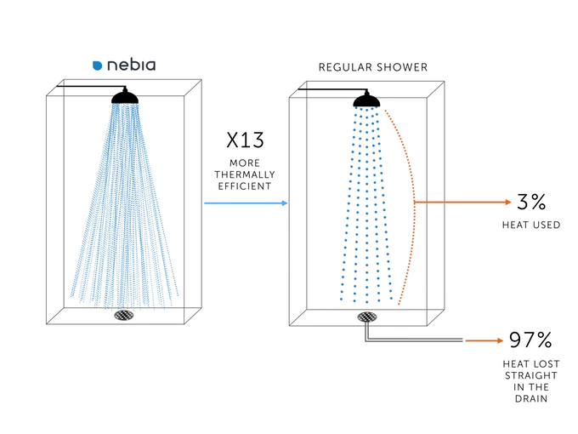

Slide 39
Summer Innovation Challenge SIC 18
Product Innovation (tech)
Process Innovation
Community Innovation
Institutional Innovation
Children Creativity Innovation

Slide 40
Thanks!
ANY QUESTIONS?
You can find me at
@dhruvsaidava
dhruvsaidava@gmail.com

Slide 41

Credits
Slide Carnival
World Resources Institute India

Slide 42
Time to Take Selfie Who have I Phone X ?

Slide 43
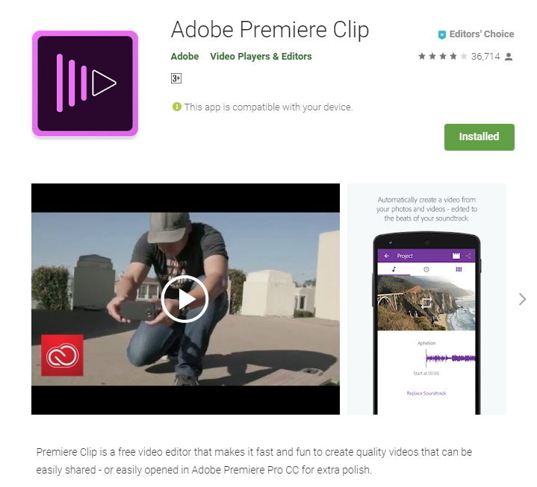

SIMPLE EASIER FASTER

